Slide 1
CEMS Exchange Student
Application Procedure
Guide

Slide 2
CEMS Exchange student
Application deadlines
Application deadline | Fall Semester 2026 | Spring Semester 2027 | Full Academic Year 2026/2027
Non-EU citizens | May 15, 2026 | October 15, 2026 | May 15, 2026
EU citizens | May 31, 2026 | October 31, 2026 | May 31, 2026

Slide 3
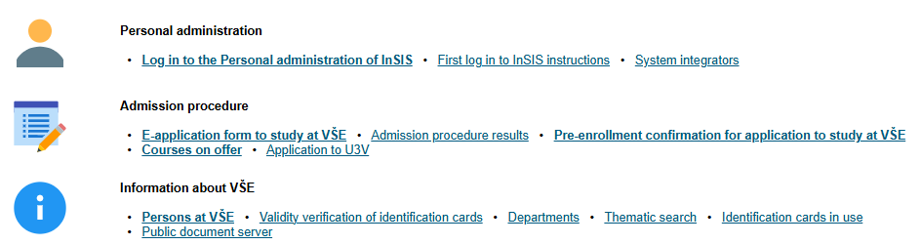
1. Log into the university system InSIS

Slide 4
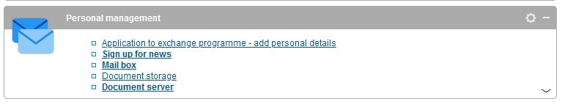
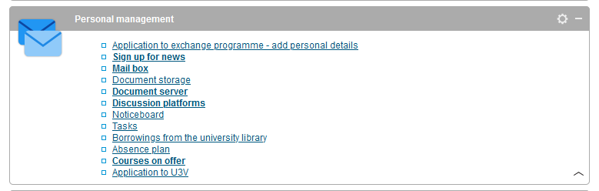
2. Go to „Personal management" section and choose "Application to exchange programme – add personal details“
To get the full offer press the small arrow in the right bottom corner of the section

Slide 5
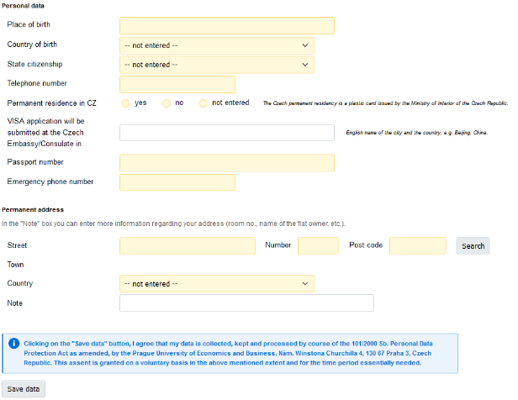
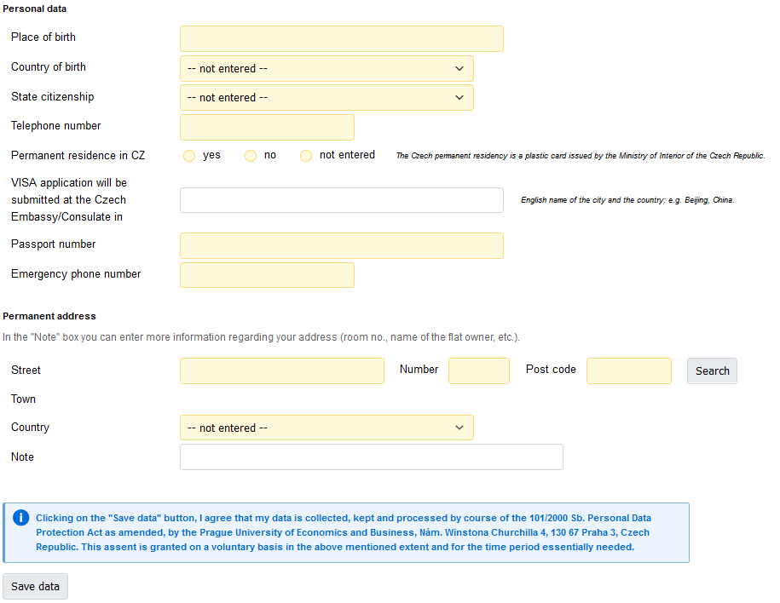
3. Fill in your Personal data
= city
Personal data
Place of birth should be a city (e.g. Paris) for US citizens please fill in city and state (e.g. Elko, Nevada)
When filling out Country of birth, State citizenship and Country, do not forget to open the scrollbar and choose from the list. Please note that countries are stated by their full official English name
State citizenship was stated by your home university coordinator, however if it is wrong or you also hold another citizenship you can change it
Phone number should start with the plus sign (+), followed by the country code (e.g. +49 69 1234 5678)

Slide 6
3. Fill in your Personal data
Permanent residence in CZ: select „yes“ only if you have a plastic card issued by the Ministry of Interior of the Czech Republic. Otherwise choose „no“
VISA application: EU citizens leave the field blank; Non-EU citizens please find the list of Czech diplomatic missions abroad here
Passport number: please note that your travel document should be valid at least 6 months after your stay is finished, EU citizens can state ID card number instead
Emergency phone number should belong to the person you want us to contact in the event of an emergency concerning you. It could be someone from your family or a close person.

Slide 7
3. Fill in your Personal data
Permanent address
Should be your official, long-term address where you are legally registered and considered to reside, not your temporary student accommodation. We expect the country of your permanent address to match your citizenship.
… When you have filled everything in, click on „Save data“ button

Slide 8
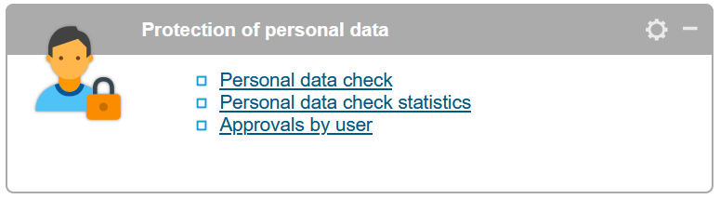
4. Personal data check
It is necessary to confirm all the personal data are correct - go to the InSIS main page and choose Personal data check in the section „Protection of personal data“

Slide 9
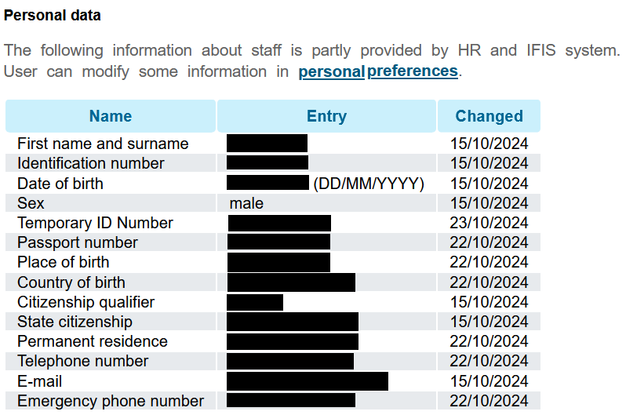
4. Personal data check
Please pay special attention to the following fields:
  Name and surname – the right order of your full name - see below:
  Date of birth – date of birth is displayed in the following format: DD/MM/YYYY
  Sex and State citizenship
You can disregard the Identification number and Temporary ID number
John | Fitzgerald | Kennedy
= Name | = Middle Name | = Last Name
= First Name |  | = Family Name
= Given Name |  | = Surname
= Prénom |  | = Nom
Please include the possible middle name(s) to the Name box.

Slide 10
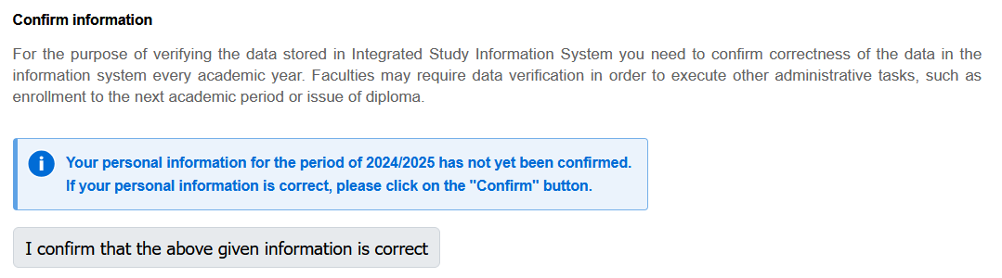
4. Personal data check
If your personal data is not correct, please send an email to your coordinator lenka.valterova@vse.cz with details of the needed update and do not forget to attach a copy of a document showing the change (for example a photo of your passport or ID card).
If your data is alright, click on the
„I confirm that the above given information is correct“ button.
2025/2026

Slide 11

5. ID type photo upload
Each VSE student is required to upload a photo. The photo also serves for preparing your VSE student ID card and your identification on the campus.
To upload your photo, choose Photo in system in the section „Personal data check“
Click change photo upload your photo according to the guidelines on next slide

Slide 12
5. ID type photo upload
ONLY a digital passport size photo, a .JPEG file, max. 5 MB, plain background
Photo requirements:
  The photo must be clear, in sharp focus, in color
  Background in white, blue or light grey is recommended, without shadows
  Taken in full-face view directly facing the camera, one person in shot only
  With a neutral facial expression, both eyes open and showing a full head
  More information can be found here.

Slide 13


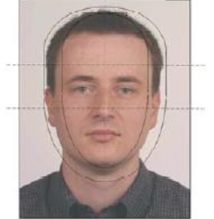
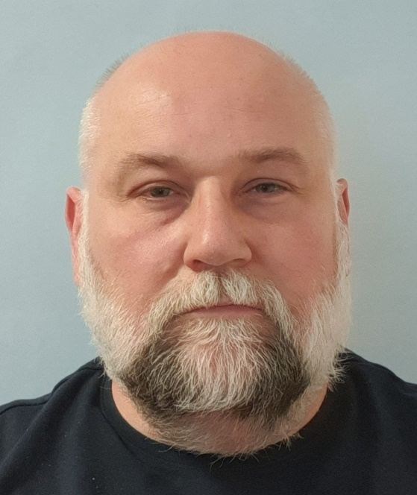

5. ID type photo upload
Examples of the correct appearance, placement and aspect ratio of an inserted photo:
Neutral facial expression
No excess space around the face
Both eyes open, between the dashed lines and on the same level
Full-face view, directly facing the camera, one person in shot only

Slide 14

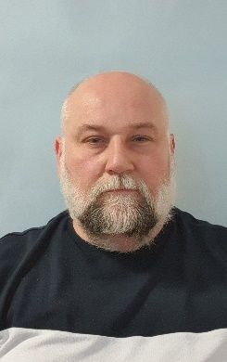
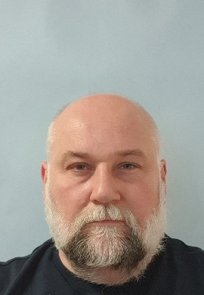
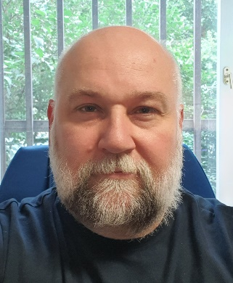
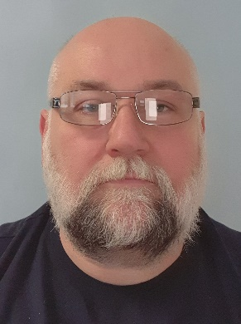

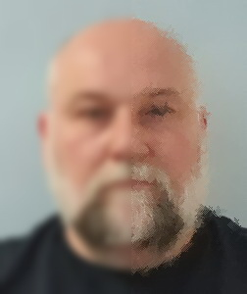
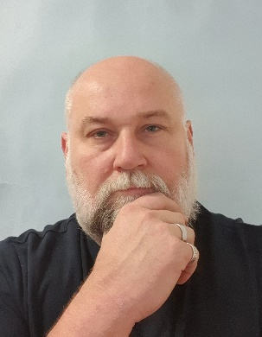
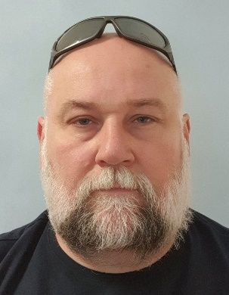
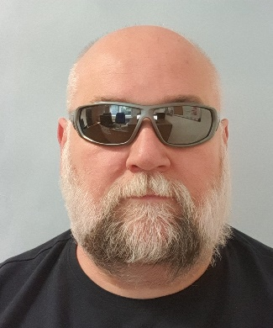
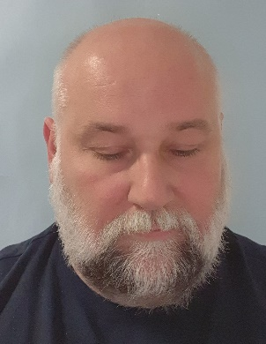
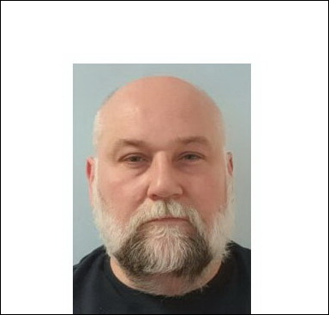
5. ID type photo upload
Non-compliant images – these types of images will not be accepted
Too much space above the head, the photo takes up the chest, not just the shoulder cutout
Lots of headroom
Inconsistent background, a uniform (not jagged) background in white, blue or light grey is recommended
There must be no
reflections of dioptric glasses on the photo
Eyes must be open and not covered in any way
The photo is not sharp, it is blurred
The photo should display only the whole head with part of the shoulders
Headgear is prohibited (except for medical reasons) as are fashion accessories such as glasses in the hair, earplugs, etc.
Glasses with dark lenses are not allowed, exception is possible only for blind persons
The person’s view must be directed into the lens
The photo was inserted with a non-original background

Slide 15
5. ID type photo upload
If your photo does not meet the criteria stated in the guidelines, it will be rejected.
To complete your online Application you will have to upload another photo.

Slide 16
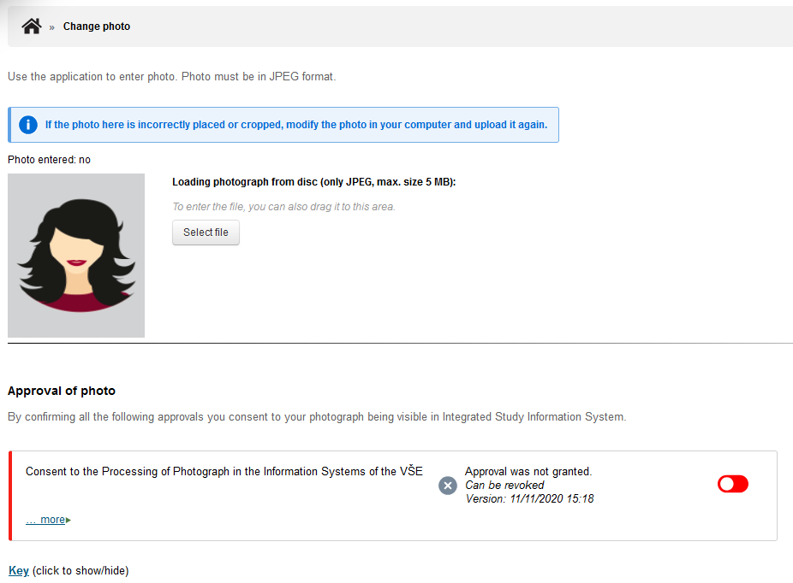
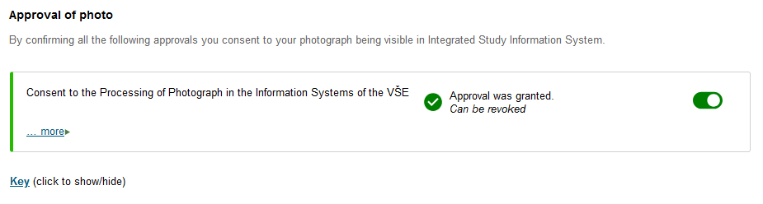
5. ID type photo upload
Lastly, do not forget to approve the Consent of the Processing of Photograph

Slide 17
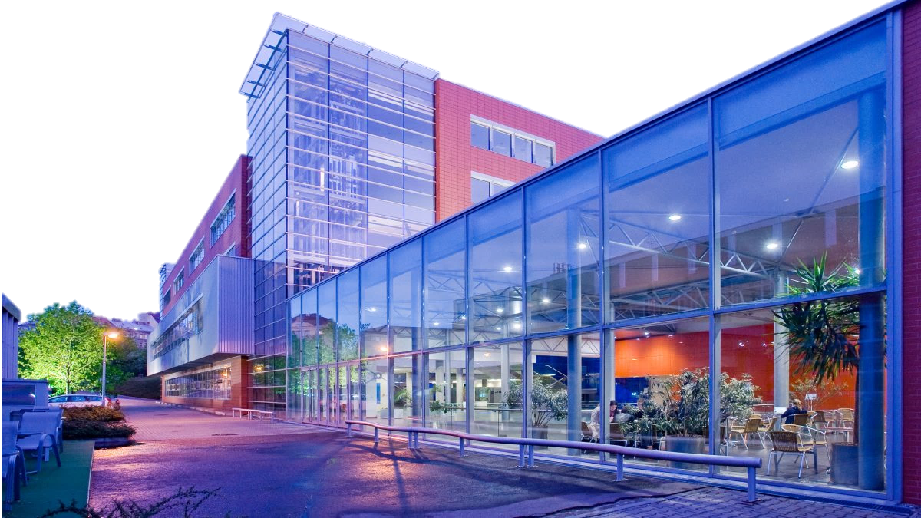
We look forward to meeting you at VSE campus!

